Slide 1
Final Project HR Analytics: Job Change of Data Scientists
Mohammad Ramadhan Akbar
(JCDS-0506 BDG)

Slide 2
Project Brief Description
Human resources (HR) is the division of a business that is charged with finding, screening, recruiting, and training job applicants, as well as administering employee-benefit programs.
So in this project I use HR data from a big company to take insight and design a simple machine learning model.

Slide 3
Project Brief Description (Cont.)
Project Objectives
Create and choose one of several machine learning models, to who will move to a new job.
Create a web application using the flask, from a model that was created and selected previously.

Slide 4
Dataset Information
Dataset Source : Kaggle.com
Dataset Info :
https://www.kaggle.com/arashnic/hr-analytics-job-change-of-data-scientists
Total Rows : ± 19.158 rows
Total Features / Columns : 14 features
Total Features Used (Model & Web App) : 9 features

Slide 5
Features / Columns Desc.
enrollee_id : Unique ID for candidate
city : City code
city_ development _index : Developement index of the city (scaled)
gender : Gender of candidate
relevent_experience : Relevant experience of candidate
enrolled_university : Type of University course enrolled if any
education_level : Education level of candidate
major_discipline :Education major discipline of candidate
experience : Candidate total experience in years
company_size : No of employees in current employer's company
company_type : Type of current employer
lastnewjob : Difference in years between previous job and current job
training_hours : training hours completed
target : 0 – Not looking for job change,
1 – Looking for a job change

Slide 6
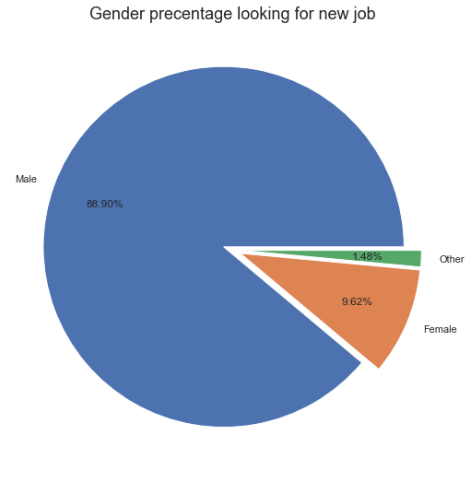
Data insights (Cont.)

Slide 7
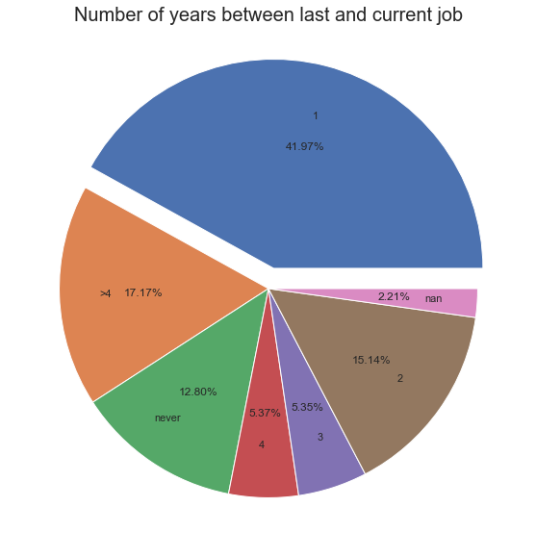
Data insights (Cont.)

Slide 8
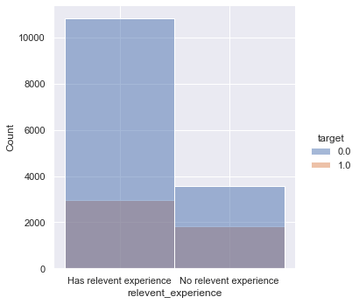
Data insights (Cont.)
Relevant Experince Looking for A New Job

Slide 9
Data insights (Cont.)

